Slide 1

Semester: IV Review: 4.1
Title of the Project: Web Scraping for Hotels
Domain:
Group Members:
Member 1 :Sahil Motiramani(37)
Member 2:Bhushan Malpani(34)
Member 3:Atharva Shinde(57)
Member 4:Shivpratik Hande(16)
Mentor Name:Bincy Ivin

Slide 2




Content
Overview
Introduction
Problem Statement
Objectives
Requirements
Literature Survey
Proposed System
Proposed Design (along with UML Diagrams)
Implementation
Results and Analysis
Conclusion
References

Slide 3
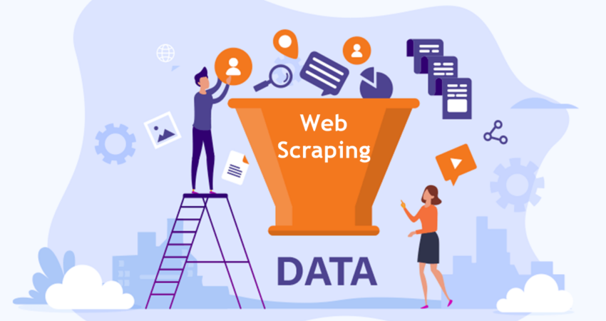
Introduction to Project
What is Web Scraping?
r Rates
Web scraping is a powerful technique that allows you to extract data from websites automatically.
In the context of hotels, web scraping enables you to collect valuable information such as hotel prices, ratings, reviews, and amenities. Whether you’re analyzing market trends, comparing pricing across different hotels, or gaining insights into the hospitality industry, web scraping can be a game-changer.

Slide 4
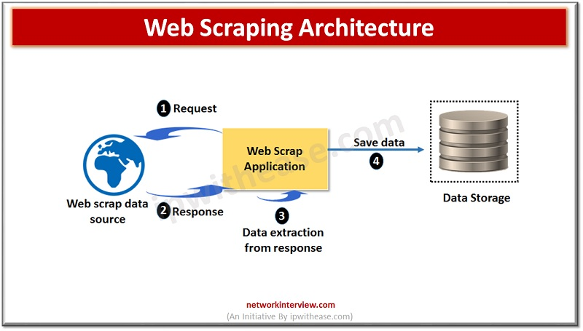
Introduction to Project
r Rates

Slide 5

Problem Statement
Develop a web scraper for hotels.
Extracts hotel names, addresses, ratings, prices and reviews.
Respects website terms of service.
Handles dynamic content loading.
Ensures compliance with data protection regulations.
Implements data parsing, cleaning, and storage for data integrity.
Scalable and reliable solution.

Slide 6
Objectives of the project
r Rates
Data Acquisition: Gather comprehensive information about hotels from various online travel platforms to create a rich dataset.
Comparison and Analysis: Enable users to compare hotels based on factors such as prices, ratings, amenities, and reviews to make informed booking decisions.
Automation: Automate the process of collecting hotel data to save time and resources for both users and businesses in the travel sector.

Slide 7
Objectives of the project
r Rates
Customization: Allow users to customize their search criteria and preferences to find hotels that best suit their needs and preferences
Decision Support: Assist users in selecting the most suitable accommodations by presenting them with relevant and up-to-date information about available options.
Monitoring Competitors: Enable businesses in the hospitality industry to monitor competitors' offerings and pricing strategies for strategic decision-making.

Slide 8
Requirements of the system (software)
1. Programming Languages:
Backend : Python
Database: Sqlite3
Frontend : Python
2. Libraries:
BeautifulSoup Python library for parsing HTML/XML documents
re Python library for regular expressions.
Pandas Data manipulation and analysis library in Python.
Requests Python library for making HTTP requests easily.
Tkinter Python library for creating graphical user interfaces.

Slide 9
Literature Survey(1)
lem Statement
Problem Statement
TITLE | PUBLISHED AT | YEAR OF PUBLICATION | FINDINGS | DRAWBACKS
Web Scraping Techniques and Applications: A Literature Review | Boulevard de l’Université, Saguenay (QC), Canada | 2021 | This paper provides an updated review of advanced web scraping techniques. Equipping scholars and managers with knowledge on effectively mining online data. | The study does not delve into specific challenges related to hotel-specific web scraping1.

Slide 10
Literature Survey(2)
lem Statement
Problem Statement
TITLE | PUBLISHED AT | YEAR OF PUBLICATION | FINDINGS | DRAWBACKS
Comprehensive Review on Techniques for Scraping Hotel Information from Online Sources | ACM Transactions on Information Systems (TOIS) | In 2018 | The survey offers structured and unstructured data extraction methods. Use of natural language processing for sentiment analysis of hotel reviews. | Lack of discussion on the scalability and efficiency of different scraping approaches.

Slide 11
Literature Survey(3)
lem Statement
Problem Statement
TITLE | PUBLISHED AT | YEAR OF PUBLICATION | FINDINGS | DRAWBACKS
Web Scraping Methods for Hotel Price Monitoring | Journal of Information Science | 2020 | This paper compares various web scraping methods specifically for hotel price monitoring applications. | Limited focus on the adaptability of scraping techniques to different hotel booking platforms.

Slide 12
Literature Survey(4)
lem Statement
Problem Statement
TITLE | PUBLISHED AT | YEAR OF PUBLICATION | FINDINGS | DRAWBACKS
State-of-the-Art Techniques in Web Scraping for Hotel Booking Data | International Conference on Web Engineering (ICWE) | 2017 | Advancements in automated data collection, such as headless browsing and proxy rotation. addresses challenges related to data quality assurance and privacy concerns. | Limited discussion on the impact of website layout changes on scraping accuracy.

Slide 13
Literature Survey(5)
lem Statement
Problem Statement
TITLE | PUBLISHED AT | YEAR OF PUBLICATION | FINDINGS | DRAWBACKS
An Overview of Web Scraping Methods for Hotel Information Retrieval | Journal of Big Data | 2021 | Covers techniques such as DOM parsing, web crawling, and API integration. | Limited analysis of the legal and ethical considerations associated with web scraping practices.

Slide 14
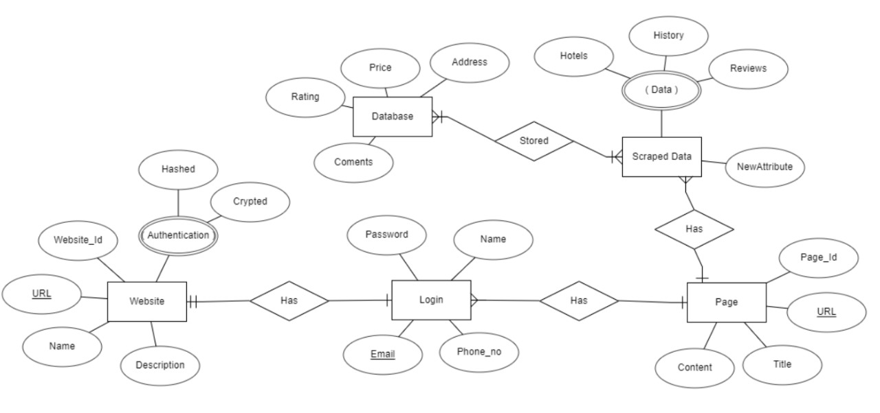
ER-Diagram

Slide 15
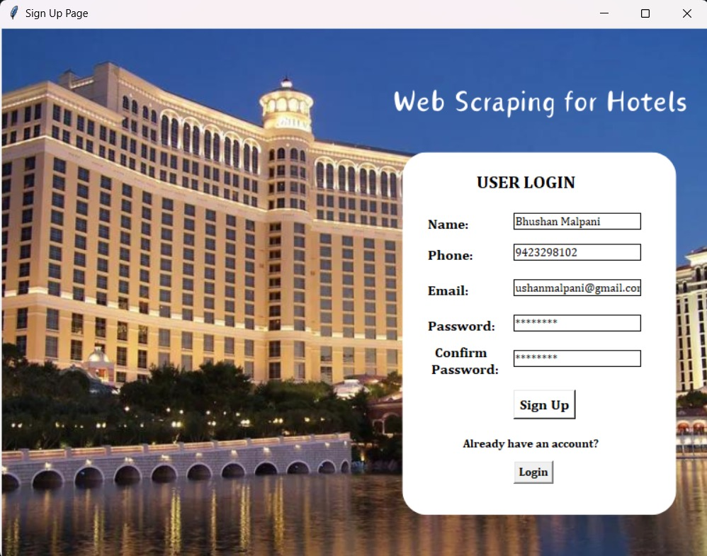
Implementation

Slide 16
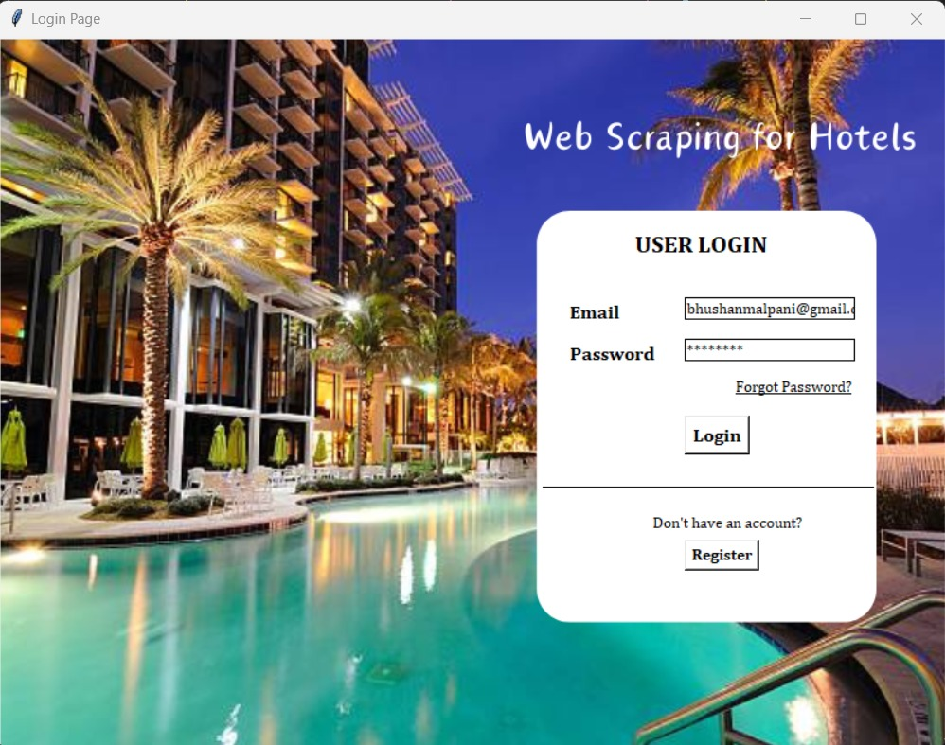
Implementation

Slide 17
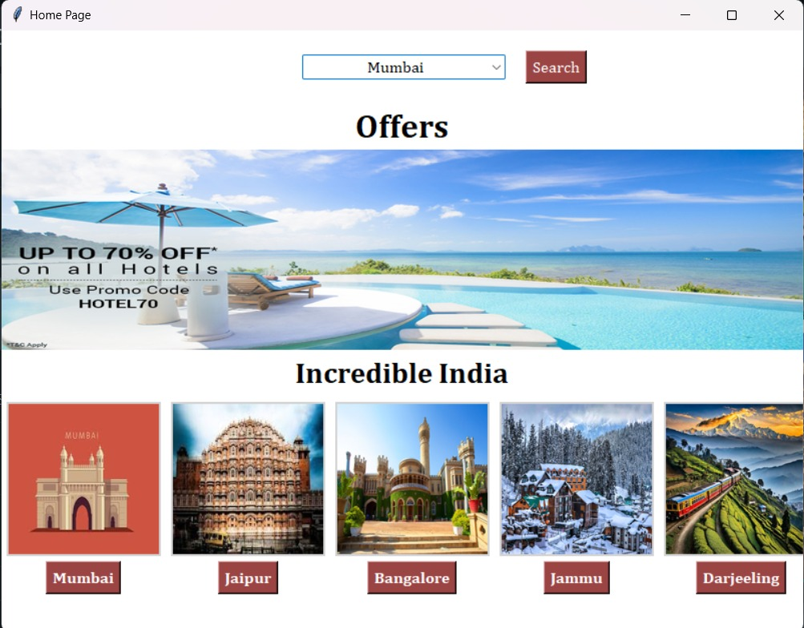
Implementation

Slide 18
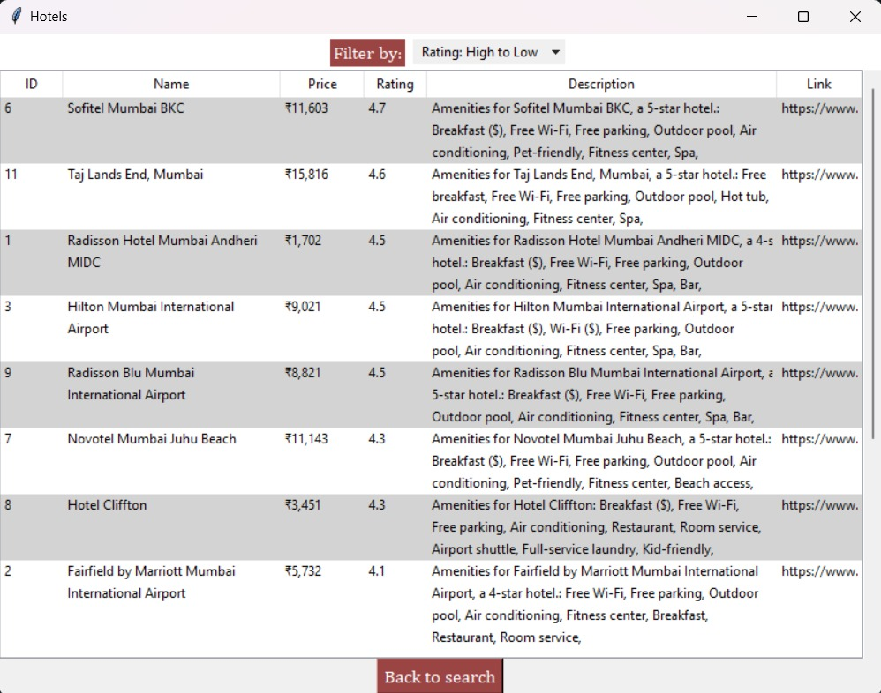
Implementation

Slide 19
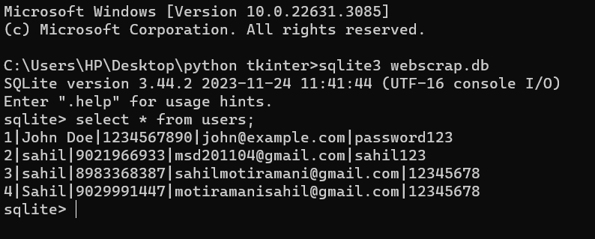
Implementation

Slide 20
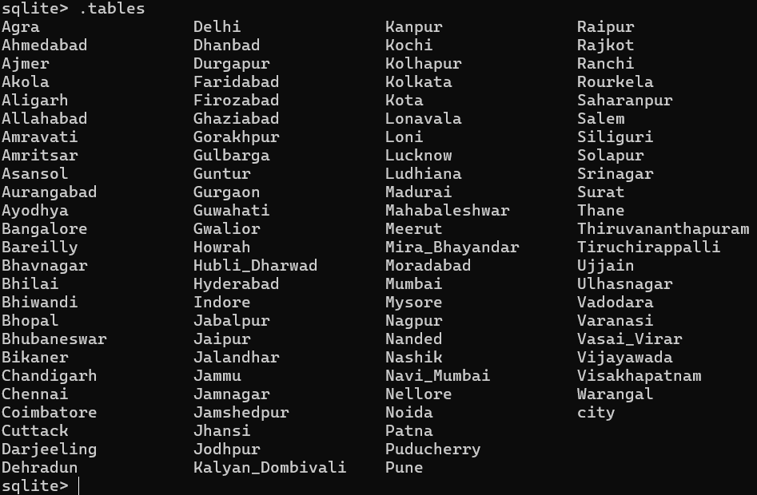
Implementation

Slide 21
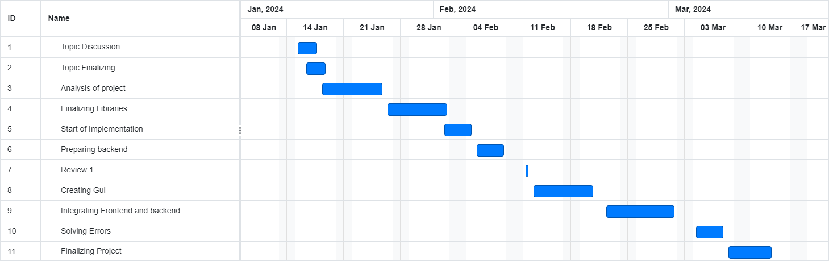
Gantt Chart
lem Statement
Problem Statement

Slide 22
Conclusion
Web scraping for hotels streamlines data access, enabling users to make informed decisions by automating the collection of hotel information.
It enhances the user experience by simplifying the search and comparison process, improving efficiency in booking accommodations.
Compliance with legal and ethical standards is crucial for maintaining trust and integrity while utilizing web scraping technology.
Overall, web scraping offers valuable insights into market trends and customer preferences within the hospitality industry, facilitating better strategic decision-making for businesses.

